Slide 1
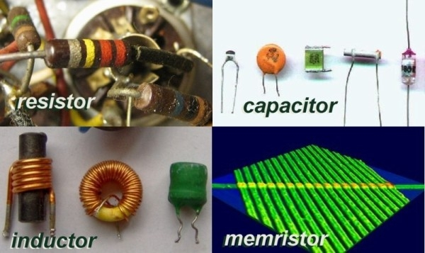

Resistive switch Red-Ox behavior as mechanism behind the operation of polyaniline memristors and neural network elements and PANI-based thermolectrochemical cells
O.Bogomolova¹ , J.Boeva¹, V.Sergeyev¹, D.Godovsky²
¹ Moscow State University, Chemistry Dept., Vorobievy Gory, 1 Moscow
² INEOS RAS, Vavilova str, 28, Moscow
Also at LG TCM, LG Electronics, Moscow, Paveletskaya, 2/3

Slide 2
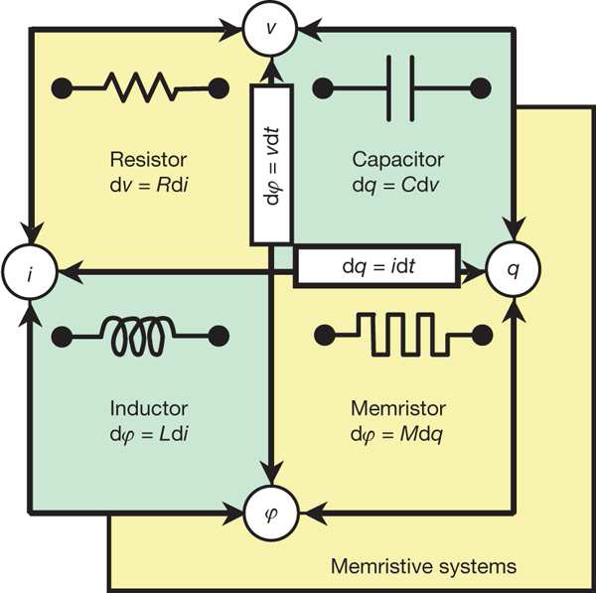
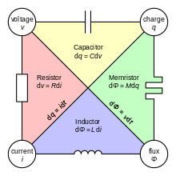
LEON CHUA THEORY BEHIND THE OPERATION OF MEMRISTOR (1971)

Slide 3
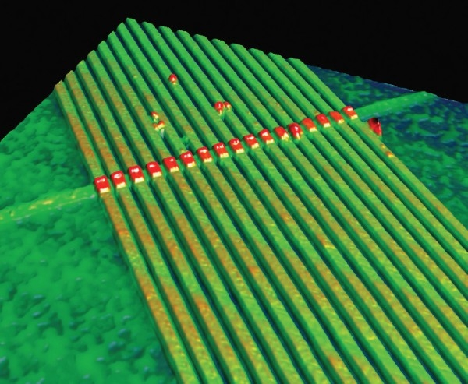
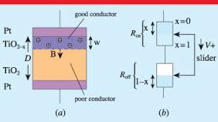
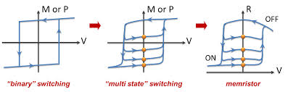
PRINCIPLE OF OPERATION OF TiO₂ MEMRISTOR
(STAN WILLIAMS, HP LABS, 2012)

Slide 4
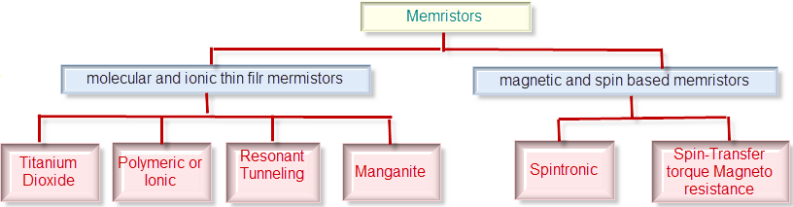

TYPES OF MEMRISTORS
BESIDES MEMRISTORS THERE ARE NOW MEMCAPACITORS AND MEMINDUCTORS!

Slide 5
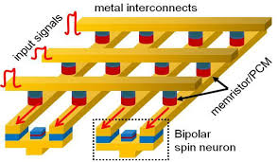

NEUROMORPHIC COMPUTERS – PROJECT SYNAPSE - DARPA
[log]
von Neumann Machines
A trade between universality and efficiency
Machine Complexity
e.g. Gates;
Memory;
Neurons;
Synapses
Power;
Size
Neuromorphic Machines
Human level performance
Dawn of a new age
Dawn of a new paradigm
Program Objective
“simple”
“complex”
[log]
Environmental Complexity
e.g. Input Combinatorics
Axonic electrode
Dendritic electrode
Crossbar synapse
Soma

Slide 6
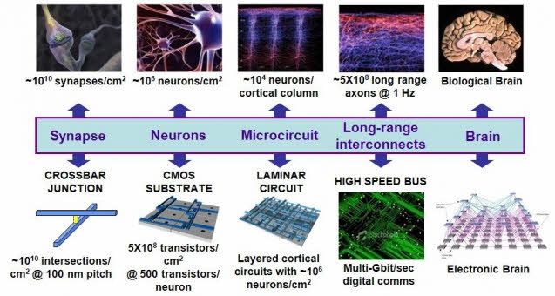
NEUROMORPHIC COMPUTING ROADMAP

Slide 7
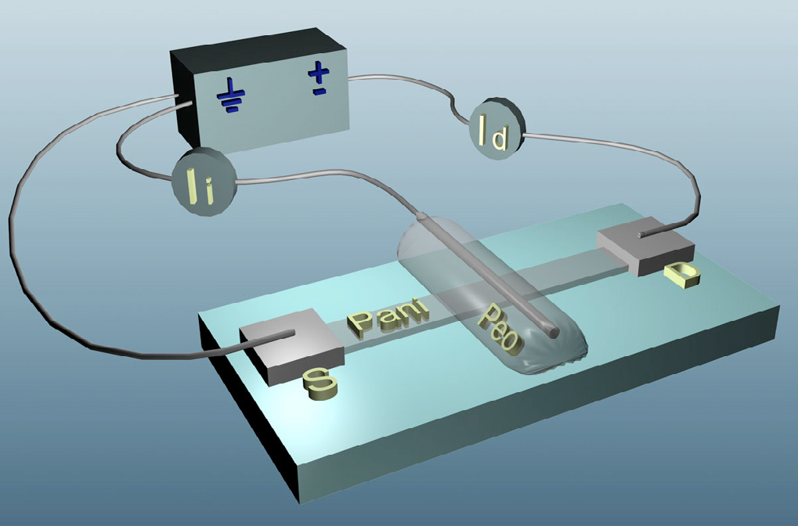
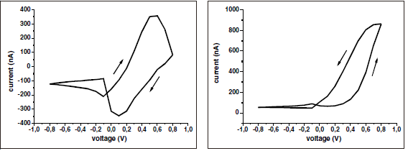
PANi BASED MEMRISTOR – EROKHIN, FONTANA - 2008
Ionic current
Electronic current

Slide 8
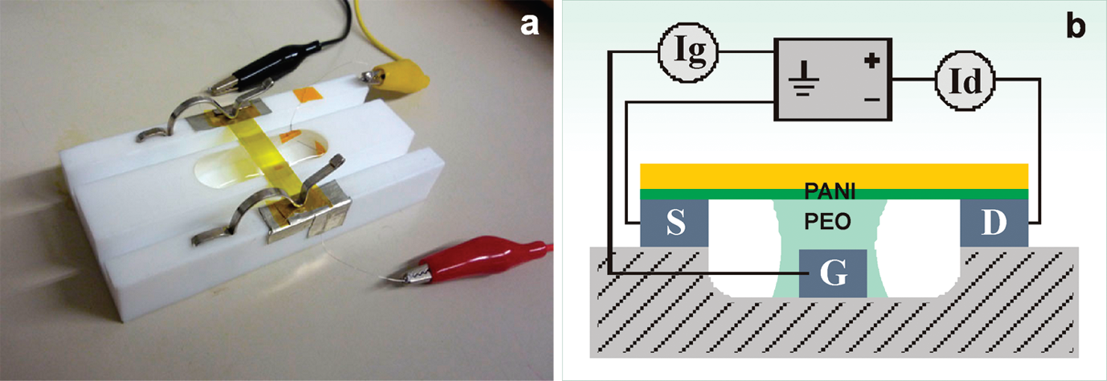
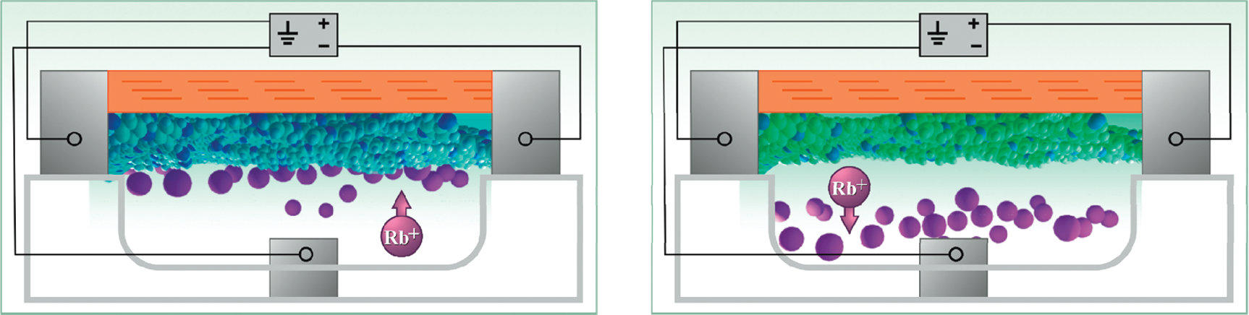
FIRST ATTEMPTS TO INTERPRET PANi MEMRISTOR OPERATION MECHANISM – EROKHIN, 2013

Slide 9
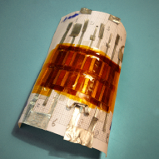
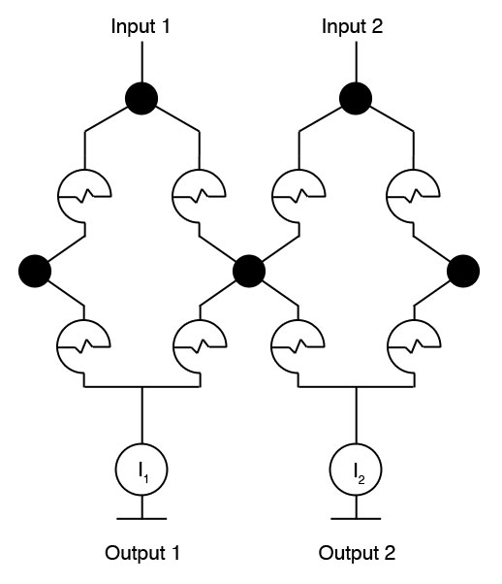
SET OF 8 PANi BASED MEMRISTORS ON FLEXIBLE SUBSTRATE
Simple learning procedure
 | Out 1 (nA) | Out 2 (nA)
Before training | 120 | 32
After training | 65 | 124

Slide 10
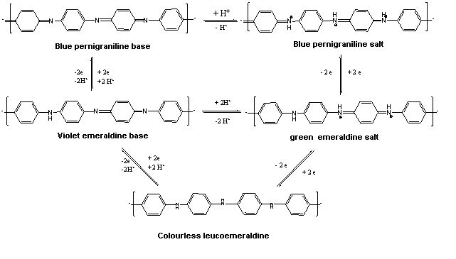
RED-OX STATES OF PANi AND ELECTROCHEMICAL TRANSITIONS BETWEEN THEM

Slide 11
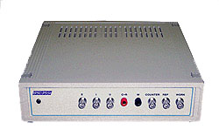
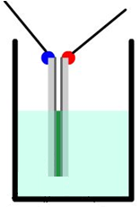
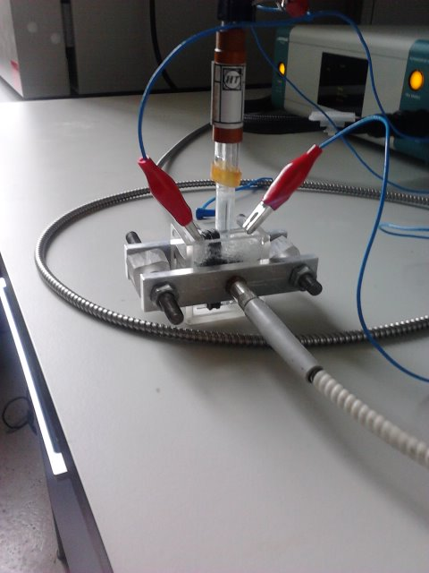
MEASUREMENT SET UP AND EXPERIMENTAL PROCEDURE
Electrochemical potentiostat
_{Measured film}
Solution HCl/LiClO₄
_{acetonytile, water}
ITO glasses

Slide 12
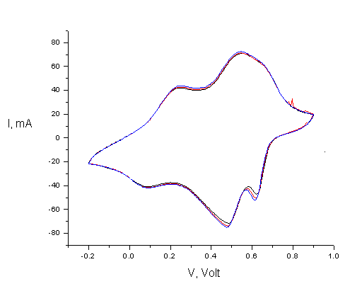
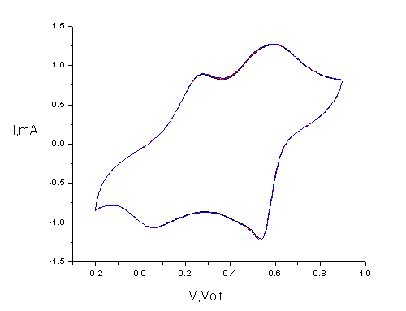
PANi IN SOLUTION OF LiClO₄/HCl CYCLOVOLTAMMETRY
Red – Ox peaks are very broad, it is important
Cyclovoltammogramm in 0.1 M HCl in water
Cyclovoltammogramm in 0.1 M LiClO₄ in acetonytrile

Slide 13

ELECTROCHROMIC CYCLOVOLTAMMOGRAMM

Slide 14
SPECTROELECTROCHEMISTRY MEASUREMENTS
PANi film versus Ag/AgCl, 0.1 M HCl Water
Backwards, with memristive effect on absorbance spectra

Slide 15
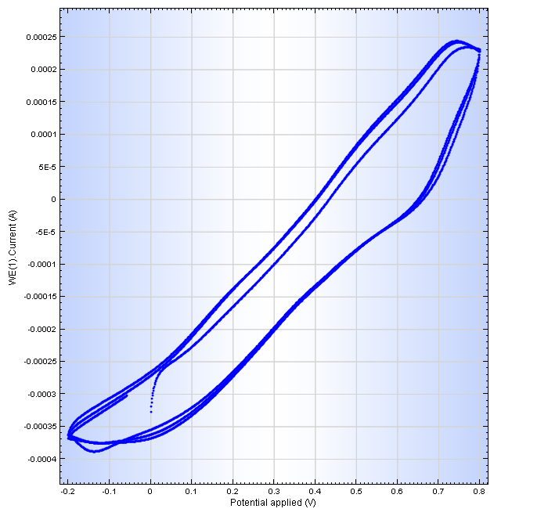
MEMRISTIVE EFFECT IN_PLANE CONDUCTANCE (I-V CURVES)

Slide 16
PANI FILM-THROUGH CONDUCTIVITY MEASUREMENT
Max I = 0.01 A
PANi film conductivity, 0.1M HCl water, Ag/AgCl

Slide 17
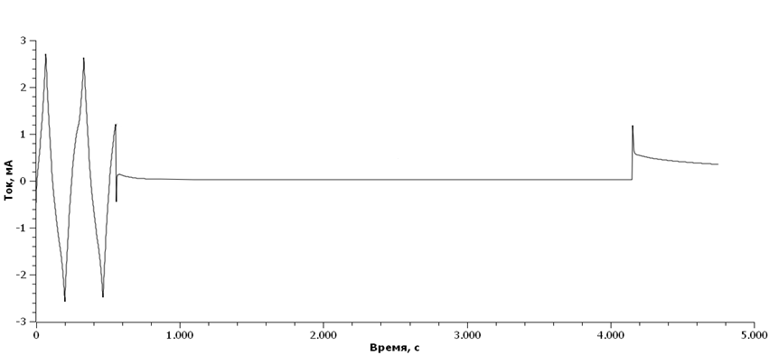
MEMRISTIVITY: RESISTANCE AFTER SWITCH OFF VOLTAGE
Cyclovoltammogramm ±2V
Switch off at 700 mV
Supplied again 700mV
Device is switched off here
I, mA
Time,sec
Memristive effect as from voltage switch off/ switch on.

Slide 18
RESISTANCE IN PLANE, DRY FILM – AC CONDUCTIVITY
Bias voltage – 0, amplitude – 5 mV

Slide 19
MEMRISTIVE EFFECT MOVIE

Slide 20
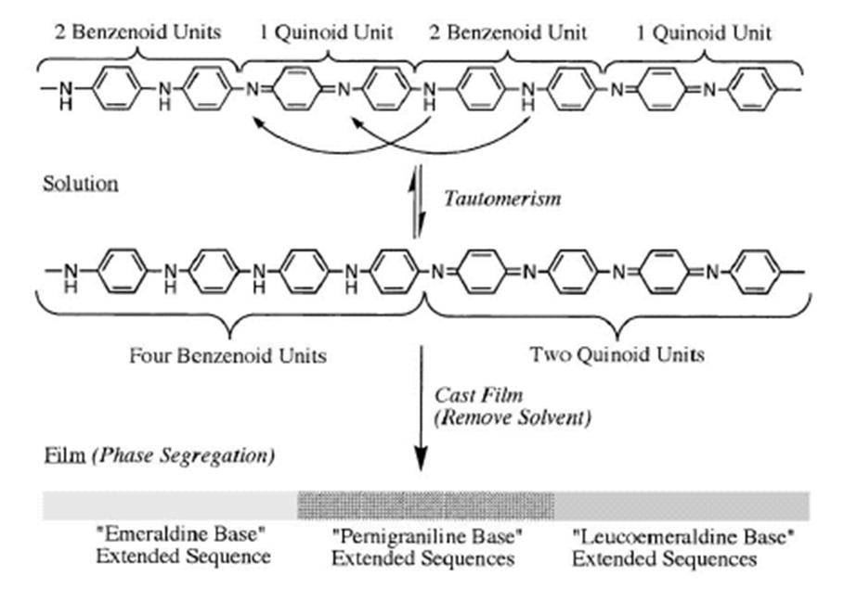

BLOCK NATURE OF CONDUCTIVITY IN PANi
– EXPLANATION OF MEMRISTANCE

Slide 21
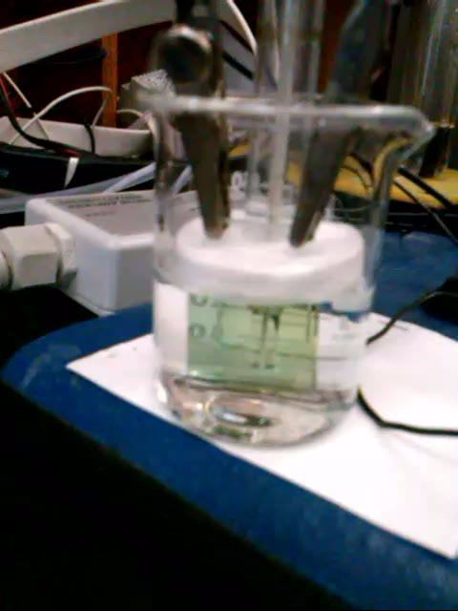
PROPAGATION OF RED-OX FRONTS IN PANi
AS A BASIS FOR NEURAL NETWORKS

Slide 22
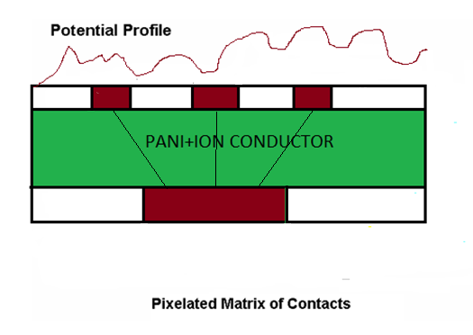
USE OF PANi NEURAL NETWORK FOR IMAGE PROCESSING
Image processing operations possible:
1.Image segmentation
2.Contrasting
3.Simple object recognition

Slide 23
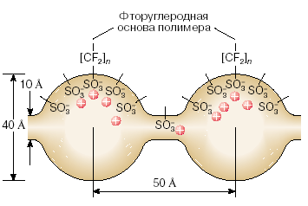
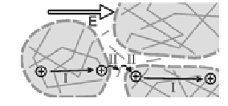
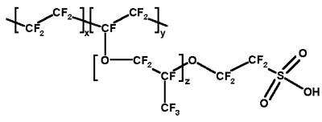
PANi-NAFION INTERPOLYELECTROLYTE COMPLEXES
Fluoropolymer base
Green emeraldine salt
Colourless leucoemeraldine

Slide 24
PANi-NAFION IN SOLUTIONS OF LiClO₄, Acetonytrile
Cyclovoltammogramm in 0.1MLiClO4, acetonytrile, versus Ag/AgCl
Absorbance spectra of films during cyclovoltammetry

Slide 25
CONCLUSIONS
Polymer electrochemistry is a complicated matter
Polyaniline-based memristor operating mechanism is determined by change of Red-Ox states of PANi
Probably TiO₂, VO_{x} memristors operation is similar.
It is not clear why PANi-Nafion films do not change Red-Ox states
It is possible to make simple neural networks based on PANi

Slide 26
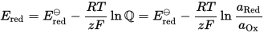

Protonated PANi
Deprotonated PANi
- H⁺
E_{f}
Built-in field
-
-
Thermo-emf
+
-
-
holes
-
-
h⁺
h⁺
h⁺
+
+
+
-
-
h⁺
h⁺
h⁺
+
-
+
+
-
-
+
-
Holes
Protons thermodifusion
Protons
Hot end
Cold end

Slide 29
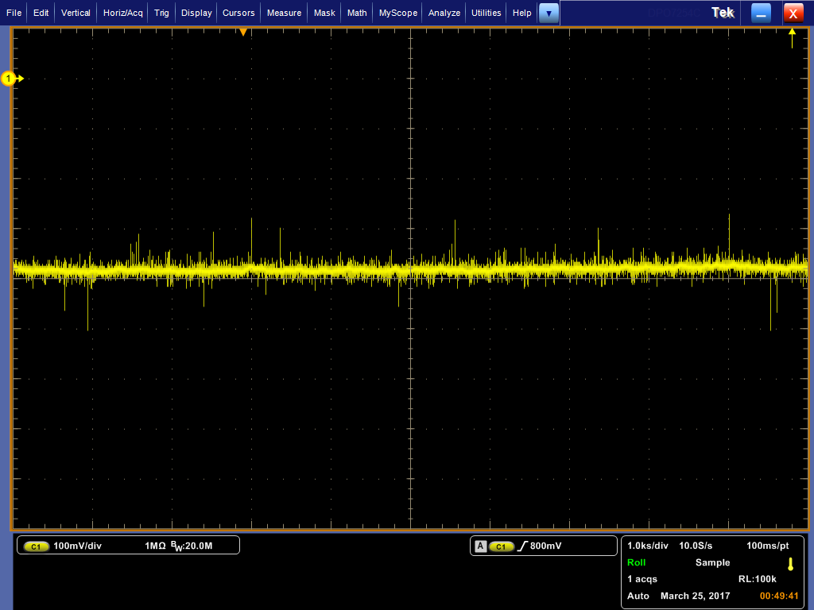
Stability at 55ºC

Slide 30
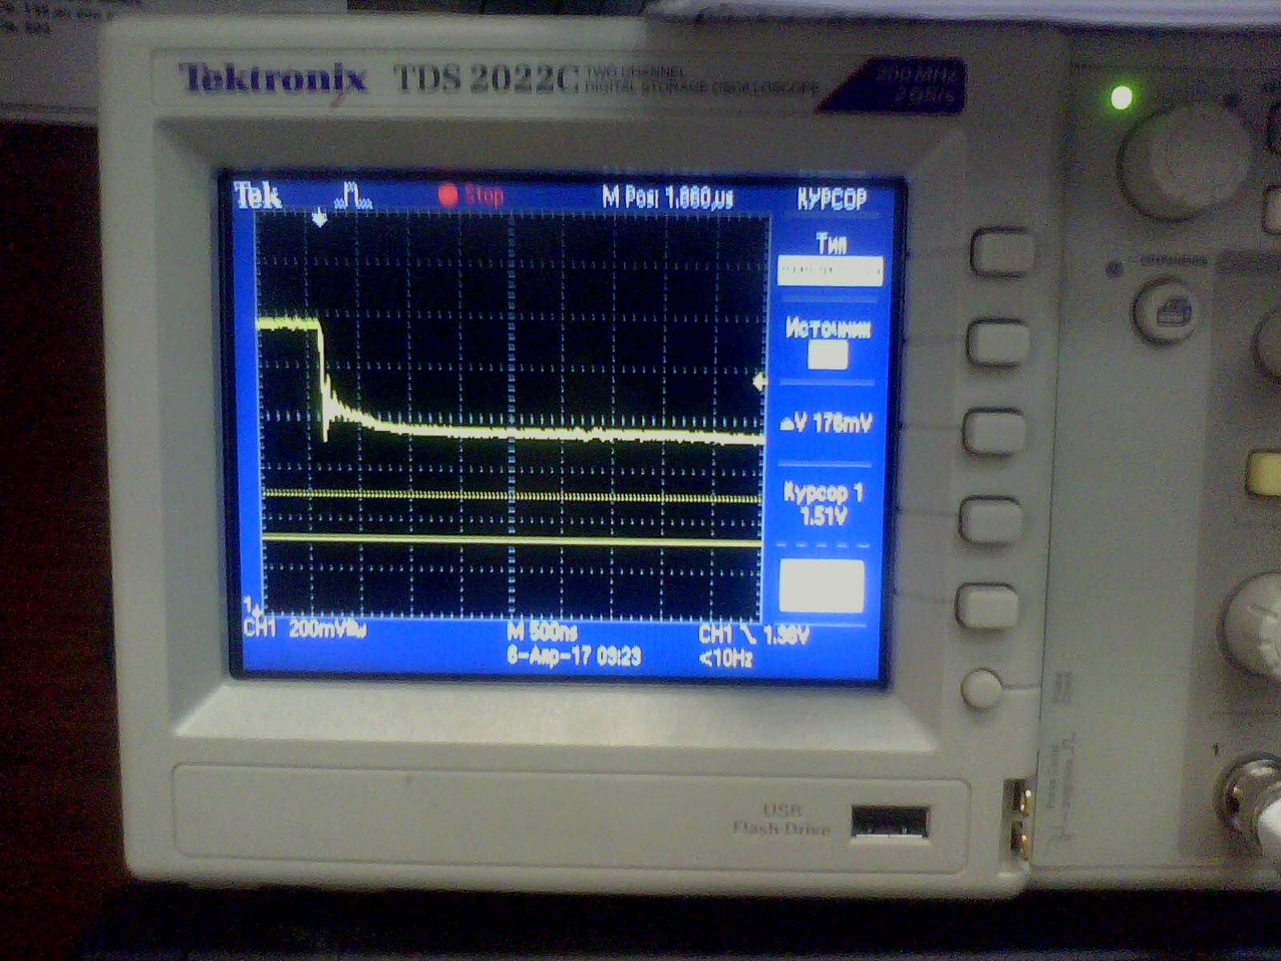
Discharge to short circuit

Slide 31
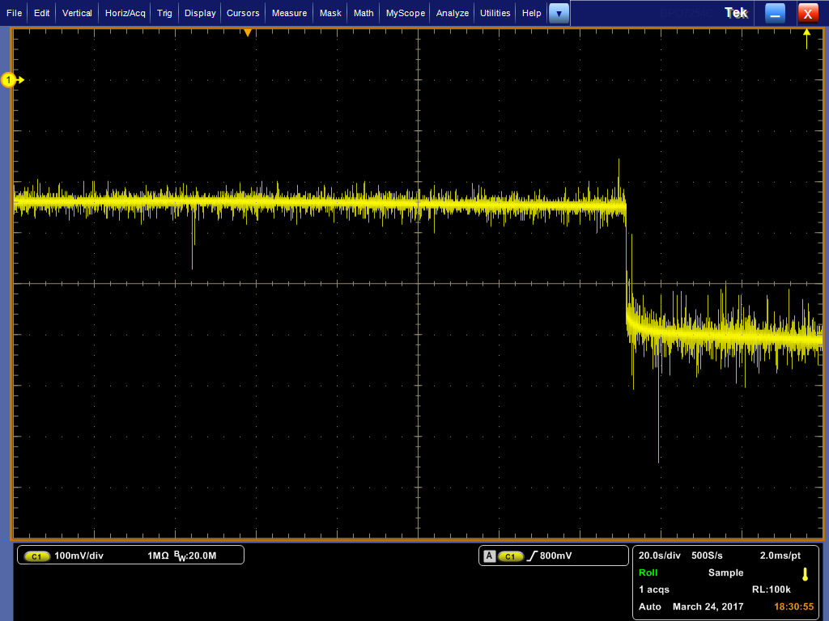
Discharge to 3 Ohm

Slide 32
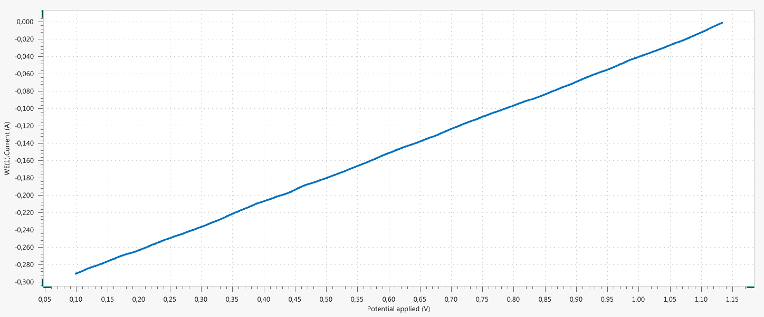
I-V curve at 40 C

Slide 33
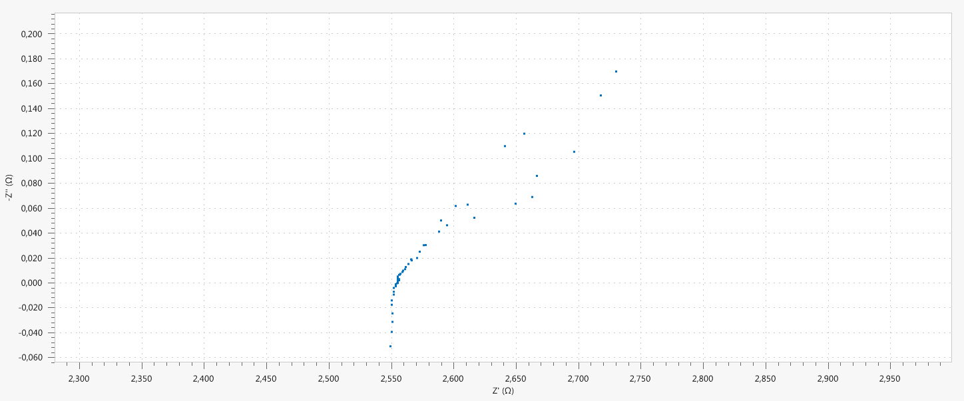
Impedance at 40 C

Slide 34
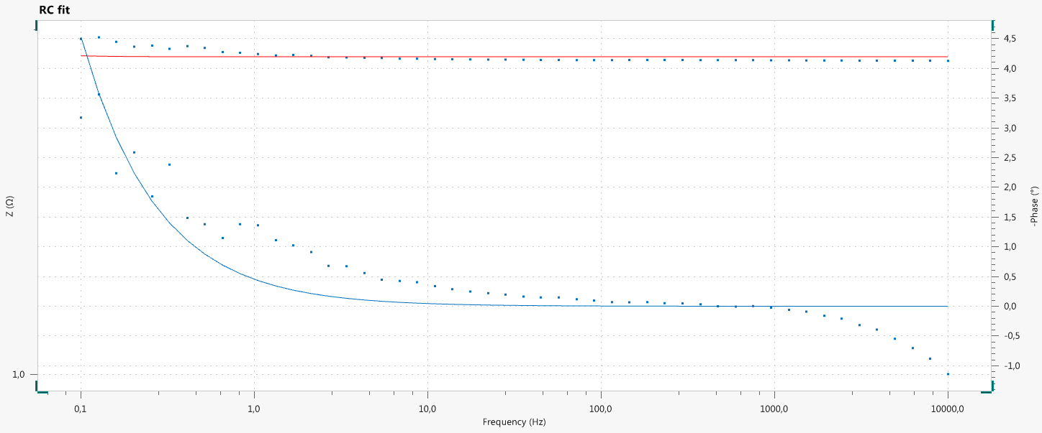
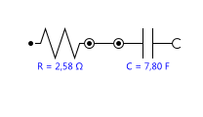
Results of approximation of equivalent circuit

